Slide 1
Unit 2-A Present Perfect Statements
Touchstone 3
A class by Mr. Jean Paul Quiñonez

Slide 2
What is present perfect?
I have finished my homework.
José has stopped smoking.
Our families have agreed on a meeting.
My cat has ran away.
A reference to events at an indefinite time before now

Slide 3
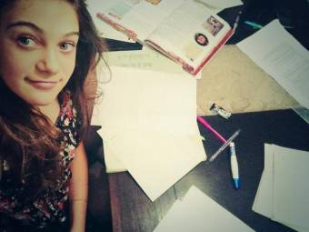
How to use the present perfect
I-YOU-WE-THEY + HAVE + PAST PARTICIPLE
HE-SHE-IT + HAS + PAST PARTICIPLE
I have visited Cuzco many times.
You haven’t drunk that coffee.
She has done her homework.
Maria has tried to call you.

Slide 4
Frequency expressions to be used with present perfect
Indefinite past statements
We have always wanted to buy that house.
My sister has gone to the cinema twice this week.
How many times have you visited this restaurant this week?
I’ve been there three times so far.

Slide 5
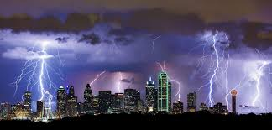
Immediate past expressions
We refer to the immediate past but DO NOT specify when
They haven’t played any sports recently.
I have gone dancing twice this month.
There have been many electical storms in the area lately.
Sofia has stayed home.

Slide 6
Regular vs. Irregular verbs in past participle
Regular
Travel traveled
Work worked
Live lived
Stay stayed
Like liked
Similar to the simple past
Irregular
Sleep slept
Cut cut
Go gone
Be been
Get gotten
Different from the simple past

Slide 7
Have you traveled to Europe?
Yes, I have been there many times.
We haven’t gotten any news from her.
We haven’t called her either.
There hasn’t been any traffic problems downtown.
However, the police haven’t stopped doing their job.

Slide 8
GO or BE?
Not the same intention
You went to a place and you are still there.
I have gone to my grandma’s house because she’s been a little ill.
You went to a place and returned.
My parents and I have been to Arequipa many times this year.

