Slide 1
Unit 5-A QUANTITIES OF FOOD
Touchstone 3
A class by Mr. Jean Paul Quiñonez

Slide 2
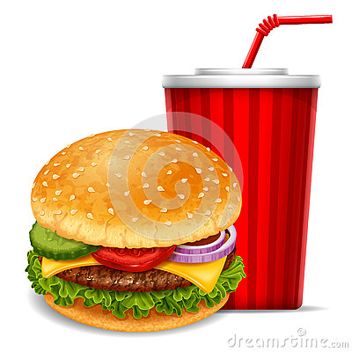
FOOD / FOODS
Do you need any bananas for the dessert you are preparing?
No, I don’t need bananas, I would like some strawberries.
We are having some onion soup for dinner tonight.
Right, that seems ok. I’m going to buy some bagette bread to enjoy it better.
I’d like to eat a hamburger and drink a glass of soda because I’m hungry.

Slide 3
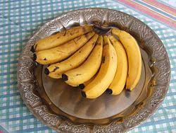
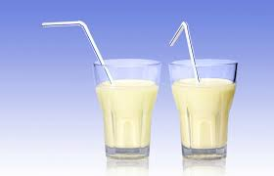
HOWEVER
I like the bananas, can you buy a kilo of bananas for tomorrow?
My daughter doesn’t drink much milk, she just drinks a couple of glasses a week.
We need to recognize the countable from the uncountable nouns and how to use them
Countable
VS
Uncountable
Nouns

Slide 4
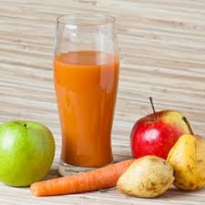
Countable nouns
There are 3 potatoes on the table, you can boil them and smash them for lunch.
How many carrots do you need for the jam?
I just need one carrot, the rest is apples and pears.
Those are the nouns we can count, from the number 1 until the infinite

Slide 5
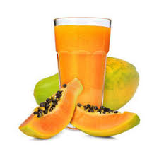
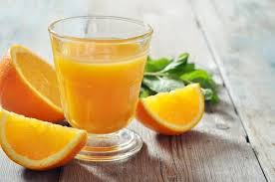
Uncountable nouns
We are drinking tea with lemon for our cold.
Is there any juice for tomorrow’s breakfast?
Of course, we have orange juice and papaya juice. Which one do you like more?
Those are the nouns we cannot count, not even with the number 1.
They only exist in the singular form

Slide 6
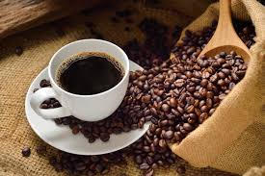
If there is no specific quantity, we can use some adverbs
QUANTITY ADVERBS
There are some onions on the fridge for the omelette, but there are only a few tomatoes, could you go to the grocery store for some more?
Sure, I think 3 tomatoes are enough.
My father would like to drink some coffee after lunch, but his doctor forbid it. I guess he is going to drink a little herbal tea instead.

Slide 7
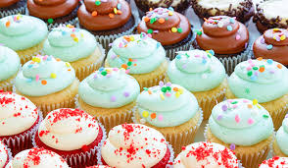
ADVERBS FOR COUNTABLE NOUNS
We bought some potatoes to fry for our burgers.
There are many cupcakes over the shelf, you can take as many as you want.
We do not have any apples for the children, let’s buy some.
There are a few/few meals I can eat now that I am sick.
Fewer vegetables are suitable for that dish.
SOME FOR AFFIRMATIVE.
ANY FOR NEGATIVE AND QUESTIONS

Slide 8
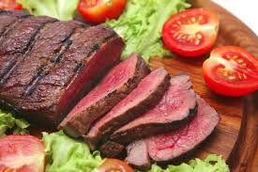
ADVERBS FOR UNCOUNTABLE NOUNS
There is some butter you can spread on your bread.
I can’t find any sugar, do you have any over there?
My doctor said I have to consume less red meat.
There is a little/very little juice in the jar, I will make some more in a minute.
We don’t have to eat a lot of salt. That’s what the doctor said.
SOME FOR AFFIRMATIVE.
ANY FOR NEGATIVE AND QUESTIONS

Slide 9
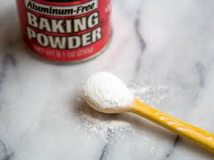
Containers, measures and weights
Especially in the case of uncountable nouns, but with all nouns, we can use a container, a specific measure or weight to indicate quantities.
I guess we have only a litter of water in the bottle, do you think we should get one litter more?
I need two tablespoons of that baking powder for my cake.
There are four kilos of that rice in the bag, would they be good for you?
I’d like a cup of tea and 2 portions of that cake, please.

Slide 10
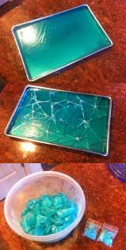
Uncountable into Countable
We have a little flour for preparing the cake.
So let’s buy 2 kilos of flour to have enough.
We are having very little chocolate in the self.
Then we need to buy 3 bars so that our guests can try some
I’d like to eat some gel-o.
There are two cups of strawberry gel-o there, you can get one.

