Slide 1
Unit 12 – B Simple past passive + by + agent
Touchstone 3
A class by Mr. Jean Paul Quiñonez

Slide 2
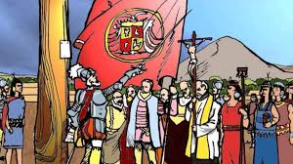
When to use passive?
Francisco Pizarro founded Lima in 1535. (active)
Pizarro did the action, Lima received the action.
Lima was founded by Francisco Pizarro in 1535. (passive)
Pizarro still did the action, Lima still received the action.
Focus on the object changes to be the most important.
Lima was founded in 1535.
Pizarro still did the action, but we do not mention it.
Passive comes from active ONLY with transitive verbs

Slide 3
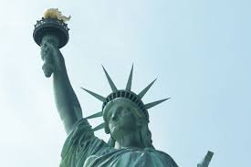
Using by
«Romeo and Juliet» was written by William Shakespeare.
The Statue of Libery was designed by Bartholdi.
The «Twin Towers» were destroyed by plane crashes.
We use BY to indicate who did the action, but it is not our focus

Slide 4
Adverbs with the passive
The car was seriously damaged after the crash.
Those tourists were dramatically affected by the accident.
Electricity was temporarilly cut while they were trying to control the fire.
Adverbs of intensity are used to emphasize effects

Slide 5
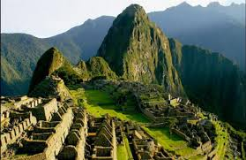
The exposers were seriously questioned after their presentation .
The public questioned the exposers, but we do not mention them.
Machu Picchu was built by the Incas thousand years ago.
The Incas bulit Machu Picchu, but the focus is on the city, not the builders
The passive voice is not a change of position. It only changes the focus over the object to give it importance

