Slide 1
Unit 1: All about you
The verb “to be”
I, you and we
Giselle Mora Velit

Slide 2
Outline: Verb Be
AFFIRMATIVE
NEGATIVE
QUESTTIONS
Form
Meaning
Use

Slide 3
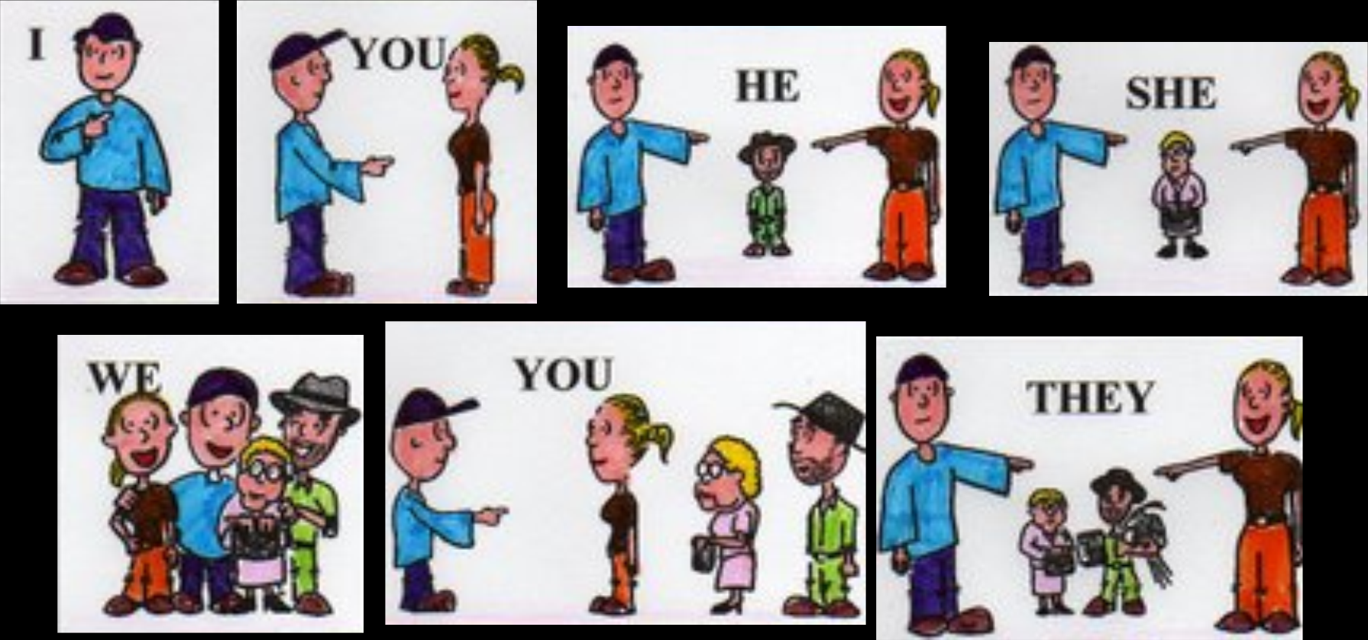
Subject pronouns

Slide 4
A: Good morning. Are you here for an English class?
B: Yes, I am. I’m Carmen Rivera.
A: Ok. You’re in room B.
C: And I’m Jenny
A: Are you Jenny Loo?
C: No, I’m not. I’m Jenny Lim. Am I in Room B, too?
A: Yes…Wait-no, you’re not. You’re in Room G.
C: Oh, no! Carmen, we’re not in the same class!

Slide 5
FORM
AFFIRMATIVE
SUBJECT PRONOUN | VERB BE | CONTRACTIONS (´)
I | AM | I’M
YOU (singular) | ARE | YOU’RE
WE | ARE | WE’RE
YOU (plural) | ARE | YOU’RE

Slide 6
MEANING
Be= ser/estar
I | am | Yo | Soy / Estoy
You | are | Tú | eres / estás
We | are | Nosotros - as | somos / estamos
You | are | Ustedes | son / están

Slide 7
We use the verb BE before nouns
I’m an artist
We’re architects

Slide 8
We use the verb BE before adjectives
I’m scared
We’re happy
me

Slide 9
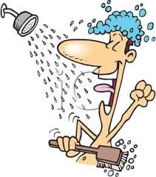
We use the verb BE before prepositional phrases
You’re in the shower
I’m from Japan

Slide 10
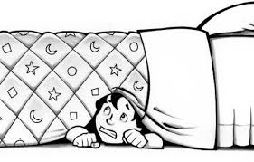
Use the picture and write sentences with BE
sad / doctors / under the bed
´m sad
´re doctors
I………… You..……………… We……………
´re under the bed

Slide 11
NEGATIVE
SUBJECT PRONOUN | VERB BE + NOT | CONTRACTIONS (´)
I | AM NOT | I’M NOT | ------
YOU | ARE NOT | YOU’RE NOT | YOU AREN’T
WE | ARE NOT | WE’RE NOT | WE AREN’T
YOU | ARE NOT | YOU’RE NOT | YOU AREN’T
THEY | ARE NOT | THEY’RE NOT | THEY AREN’T
FORM

Slide 12
I’m a nurse You’re angry We’re from China
AFFIRMATIVE | NEGATIVE CONTRACTION WITH BE | SUBJECT+ BE+ NOT
 | ----------- | I’m not a nurse
 | You aren’t angry | You´re not angry
 | We aren’t from China | We’re not from China

Slide 13
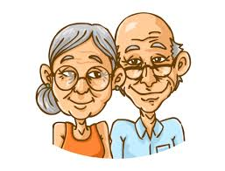
FORM
YES/NO QUESTIONS
The verb Be comes before the subject in questions
We are young.

Slide 14
FORM
QUESTIONS
Are we young?
Yes, we are
No, we aren’t

Slide 15
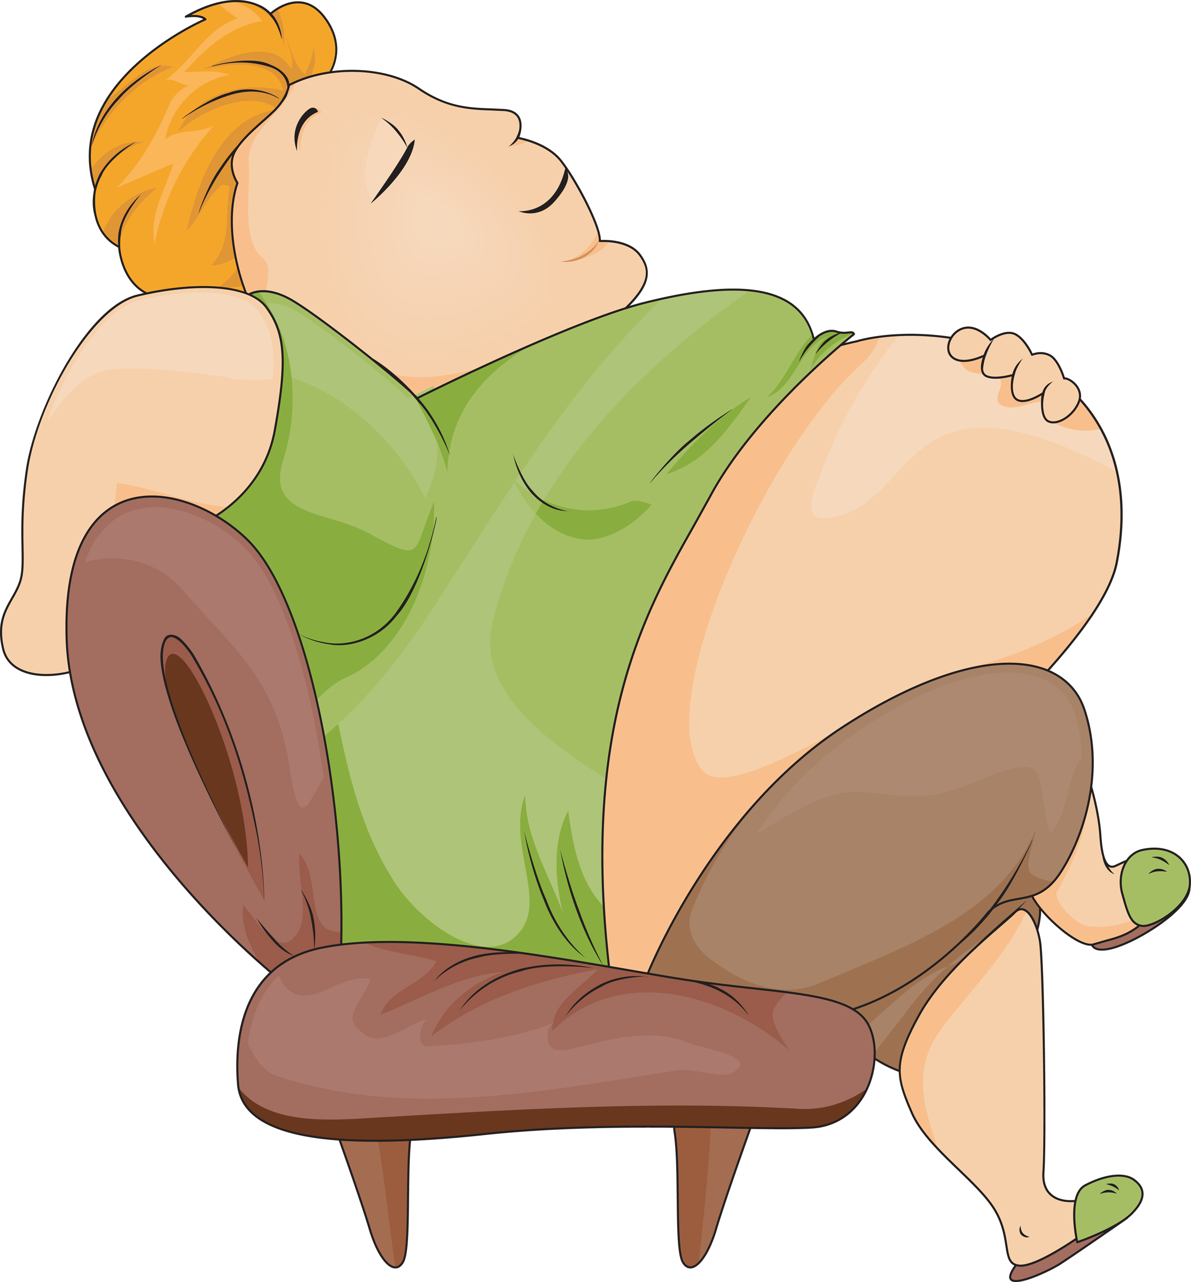
FORM
QUESTIONS
You are fat.

Slide 16
QUESTIONS
FORM
Are you fat?
Yes, I am
No, I’m not

Slide 17
QUESTIONS
Am I…? | Yes, you are. | No, you’re not.
Are you…? | Yes, I am. | No, I’m not.
Are we…? | Yes, we are. | No, we’re not.
Are you…? | Yes, you are. | No, you’re not.

Slide 18
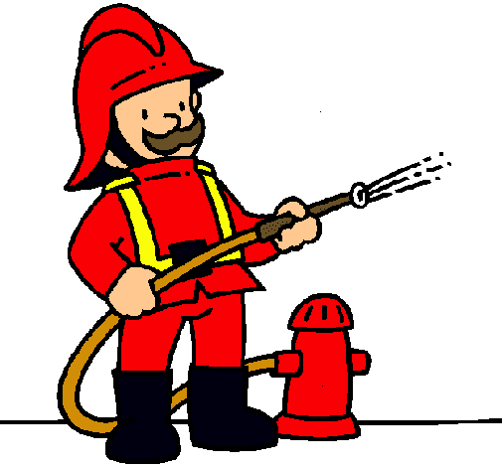
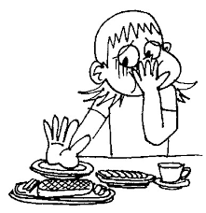
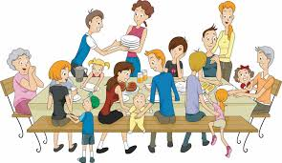
PRACTICE
I’m a firefighter.
You’re hungry.
We’re a family.

Slide 19
PRACTICE
Am I a firefighter?
Are you hungry?
Are we a family?
Yes, you are
No, I’m not
Yes, we are

Slide 20
WH-QUESTIONS
WH-QUESTIONS ASK ABOUT INFORMATION
What’s your name?
What’s your email address?
What’s your phone number?
My name’s Giselle Mora
at
dot
It’s gmora@continental.edu.pe
It’s 238191

Slide 21
PRACTICE
What’s your name?
What’s your email address?
What’s your phone number?
My name’s ………………….
It’s ………………….
It’s ………………….

