Slide 1
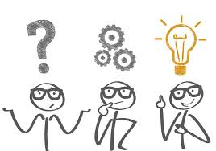
Unit 1-A Adjectives vs. Manner adverbs
Touchstone 3
A class by Mr. Jean Paul Quiñonez

Slide 2
What is an adjective?
My father is a good surgeon.
José works for a big company.
Your parents are fantastic with their friends.
My cat is fast when it hunts mice.
No matter singular or plural, it qualifies the noun about its characteristics.

Slide 3
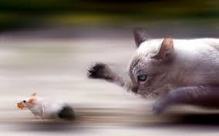
What is an adverb?
My father is a very good surgeon.
José works for a really big company.
Your parents are quite fantastic with their friends.
My cat is extremely fast when it hunts mice.
It describes the intensity or manner an action is done

Slide 4
However
We can change some adjectives into adverbs for manner by using the suffix -ly
My daughter does her homework perfectly.
I just want to do it patiently.
Life in that island passes peacefully.
Don’t you want to get to that place fast?

Slide 5
Regular adverbs ending in - ly
Extreme extremely
Patient patiently
Easy easily
Automatic automatically
Peaceful peacefully
Specific Especifically
In most cases we just add the suffix LY, but depending on the adjective, we can add LLY or ALLY.

Slide 6
Irregular adverbs of manner
Good well
Fast fast
Late late
Hard hard
We don’t use these adjectives with a suffix due to the nature of the adjective and the adverb.

Slide 7
We never use an adjective to describe an action… but an adverb
I am happy about your promotion. (adjective)
We did all the party preparation happily. (adverb)
My sister is fast. (adjective)
She run home fast to bring her jacket. (adverb)
I felt safe because my dad was driving. (adjective)
My father drove safely all the way back. (adverb)

Slide 8
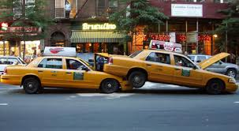
On the other side
We can use other verbs but the verb BE to describe what a noun feels.
I feel very sad when she doesn’t call me.
It doesn’t seem good for her to travel now.
The taxi driver got well two days after the accident.
Although I can say:
“I feel strongly about it”.

