Slide 1
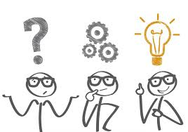
Unit 4-B USED TO – WOULD
Touchstone 3
A class by Mr. Jean Paul Quiñonez

Slide 2
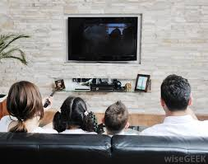
Simple past
We describe past events:
Did you go to Lima last summer?
No, I didn’t. I had no time to travel.
Who was your favorite teacher in primary?
Well, let me remember; oh yes, it was Mr. Gomez.
What did you do last night?
We just stayed home and watched a film, it was a quiet night.

Slide 3
USED TO
I used to live in New York when I was in primary school.
We didn’t use to have a break during university classes.
Did your mother use to work when you were a kid?
No, she didn’t. She started to work just when I finished high school.
The sentences formation is equal to the simple past tense for a regular verb
Regular activities or situations no longer done

Slide 4
Regular situations
My sister didn’t use to go out every Saturday night when she was in the university.
Where did you use to travel on your summer vacations?
I didn’t use to travel because my parents didn’t have enough money, but I used to walk by the seashore every morning.
Negative and interrogative sentences are less common
Those situations don’t ever happen again the same way

Slide 5
A MODAL VERB USED FOR REFERRING TO REGULAR ACTIVITIES IN THE PAST
WOULD
When I used to practice for the running competition, I wouldn’t eat any greasy or sweet food.
My grandparents used to visit us every Sunday when they were alive. We would play all the morning and then we would watch films all the afternoon.
I would study for 3 hours every night during a week before I gave my proficiency test.

Slide 6
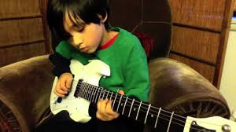
ONLY FOR ACTIVITIES, NEVER FOR SITUATIONS
Pedro would play the guitar every time her mother invited relatives to their house.
We would eat much fruit when we went to grandma’s house 10 years ago.
José and María wouldn’t finish their homework in primary school, they used to forget about it on purpose.
Questions are less common for would

Slide 7
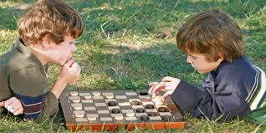
Remember
You can use USED TO (for affimative sentences in general) to describe situations or activities in the past that do not happen again or not the same way.
My parents used to cook some pork for Christmas when I was a teenager.
You can use WOULD (for affimative sentences in general) to describe only regular activities in the past.
When I was studying primary school, I’d play checkers every other day with my friends.

