Slide 1
Unit 4: Future simple with be going to and present progressive
A class by Mr. Jean Paul Quiñonez

Slide 2
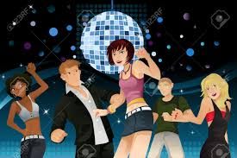
When we describe plans…
…be going to is one of the best ways to talk about the future.
Are you going to dance tomorrow night?
Yes, I am. I’m going to be in a disco.
Pedro isn’t going to play with us next Saturday.
There is going to be an exam next Friday, our teacher is going to test all the unit.

Slide 3
BE + GOING TO + VERB IN SIMPLE FORM
As we recently review
This grammar pattern cannot work without the verb BE (am, is, are).
Where are you going to go tomorrow after class?
I am going to drive directly home and I’m going to go to bed, I’m not going to go out.
This can be used either for affirmative, negative or interrogative sentences

Slide 4
When we made a previous or immediate decision over a situation.
There is no bread for breakfast, so I’m going to buy some at the shop.
I heard that is going to be the party of the year, so we are going to be there early tonight.
I didn’t know about the remedial classes, but I am going to take them anyway because it’s important for my course grades.

Slide 5
Be going to is followed by the simple form of the verb that we refer to.
When we use the verb GO the use of going to can be reduced
You are going to go to Lima on vacations.
We can say
You are going to Lima on vacations.
Is your mother going to go to the supermarket before noon?
We can say
Is your mother going to the supermaket before noon?
HOWEVER
That leads us to…

Slide 6
Present progressive with a future meaning
Are you working extra time?
No, I’m not. I’m just working a regular 9 to 5 schedule.
If you use that pattern, it
becomes just a sentence for
momentaneous actions in present.
AM / IS / ARE + VERB + ING

Slide 7
Then it is important to use a future time expression so that these sentences refer to the future
I’m sleeping after midnight tomorrow.
Are we traveling to Cuzco next weekend?
No, we are going in three weeks.
My parents are coming back from Australia next July.
Where is your sister celebrating her birthday tomorrow night?
She is going to a disco and she’s celebrating till 6 a.m. next day.

Slide 8
It’s important to refer to specific times and dates
Our teacher is giving an exam at 8 o’clock next Friday.
Are you leaving for the airport at 6 or 7 this evening?
I’m leaving before 6 to arrive on time.
José isn’t cooking a dish for his mother tomorrow morning.

Slide 9
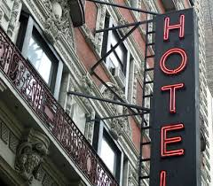
We can also use be going to for predictions
I think I am going to go to the cinema later.
So you guess it’s going to rain this afternoon.
Where are you probably going to stay when you arrive in England?
I believe we’re going to stay in a cheap hotel.

Slide 10
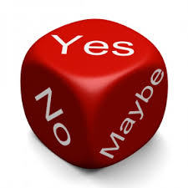
As a conclusion, we can say that
BE GOING TO COVERS UP TO OF CERTAINTY in future events.
And
PRESENT PROGRESSIVE WITH FUTURE TIME EXPRESSIONS COVERS UP TO OF CERTAINTY in future events

